Slide 1
The Problem of Induction
Assistant Professor
Mirko Farina
m.farina@innopolis.ru
* I do not claim authorship for all texts and pictures in the presentation.

Slide 2
Summary
Inductive Reasoning:
method of reasoning where one's experiences and observations are synthesized to come up with a general truth
Bottom-Up Reasoning, from Particular to Universal
Induction is widely used in the natural sciences.
3

Slide 3
- Inductively Forceful Arguments
- Cogency or Inductive Soundness
- Inductive Inferences

Slide 4
TODAY’S PLAN
1. WHY IS INDUCTION PROBLEMATIC?
2. RESPONSES TO THE PROBLEM OF INDUCTION:
EPISTEMIC INTERNALIST
EPISTEMIC EXTERNALIST
FALSIFICATIONISM
PRAGMATISM
2

Slide 5
IS INDUCTION EPISTEMICALLY JUSTIFIED?
Recall: Aristotle vs Boole on Existential Import Today we say more….
4

Slide 6
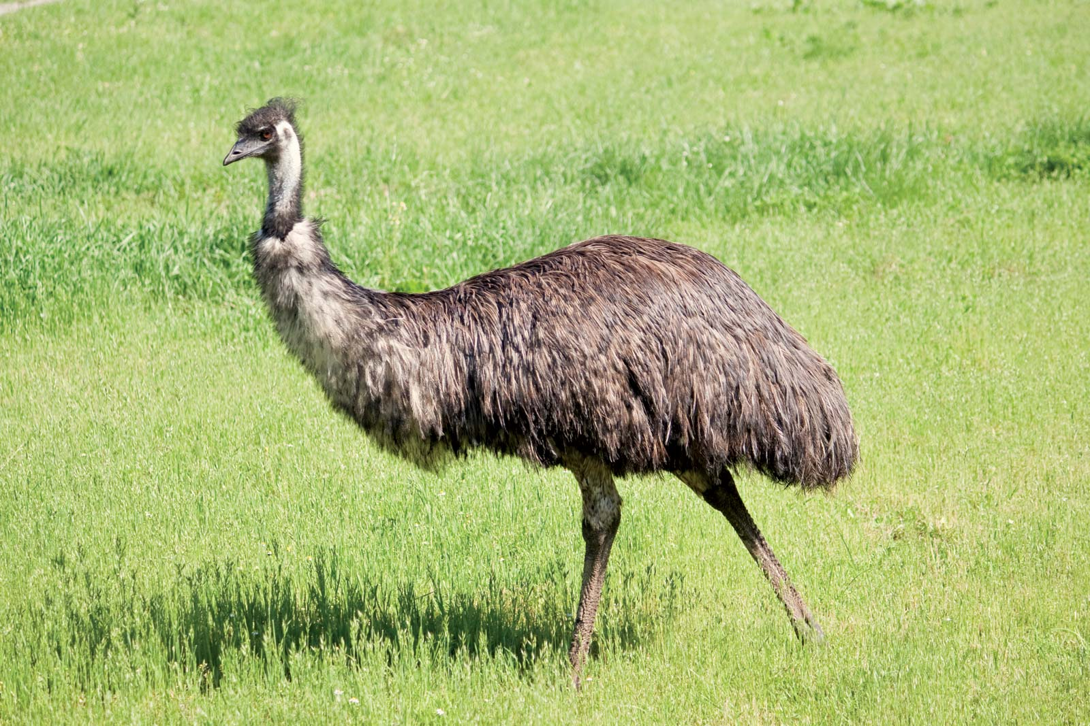
1 Every observed emu has been flightless.
Therefore:
C All emus are flightless.
Seems fine: if a. representative range and b. large
number of observations
5

Slide 7
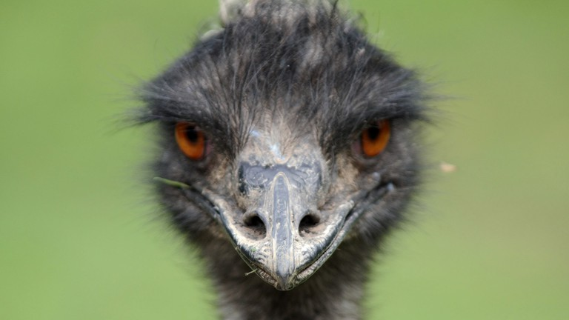
In other words: we must read 1 as 1*. That is:
1* Lots of emus have been observed over many years and in a wide range of environments, and they have always been flightless.
C. Is def more reasonable
6

Slide 8
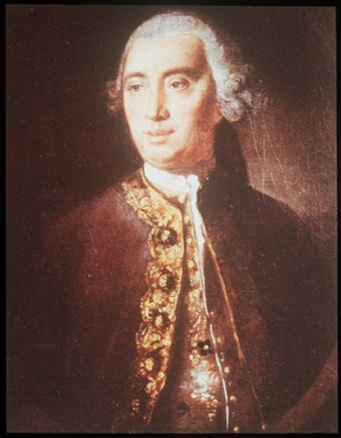
A Scottish philosopher, David Hume however raised a mighty worry:
How could we be sure that regularities that are observed within a representative sample – such as between being an emu and being a flightless bird – should increase the likelihood that the unrestricted generalisation – that all emus are flightless birds – is true?
7

Slide 9
Defense based on inductive reasoning: (what happened in the past)
But if that’s the case, then inductive inferences are only justified provided they make use of the conclusions of further inductive inferences.
(Circular Reasoning).
8

Slide 10
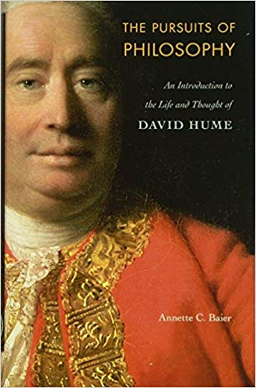
Let’s break this argument down into stages.
1* to C is problematic unless we introduce:
9

Slide 11
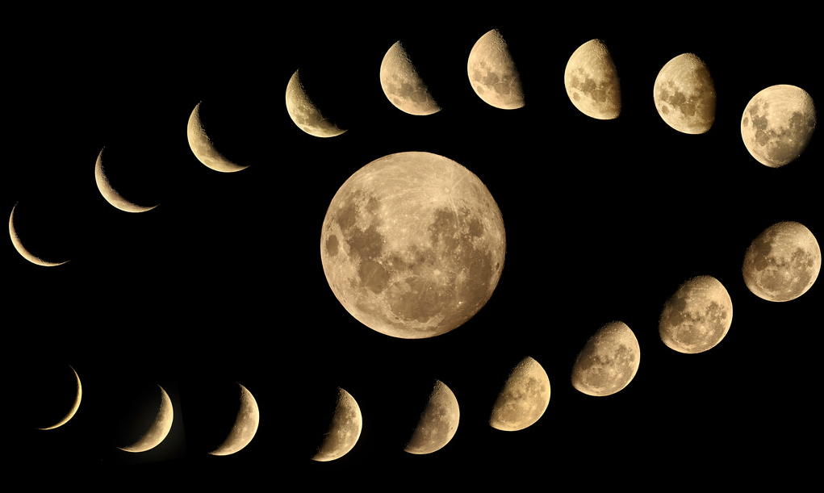
2 That a certain regularity has been observed across a sufficiently large and representative sample
10

Slide 12
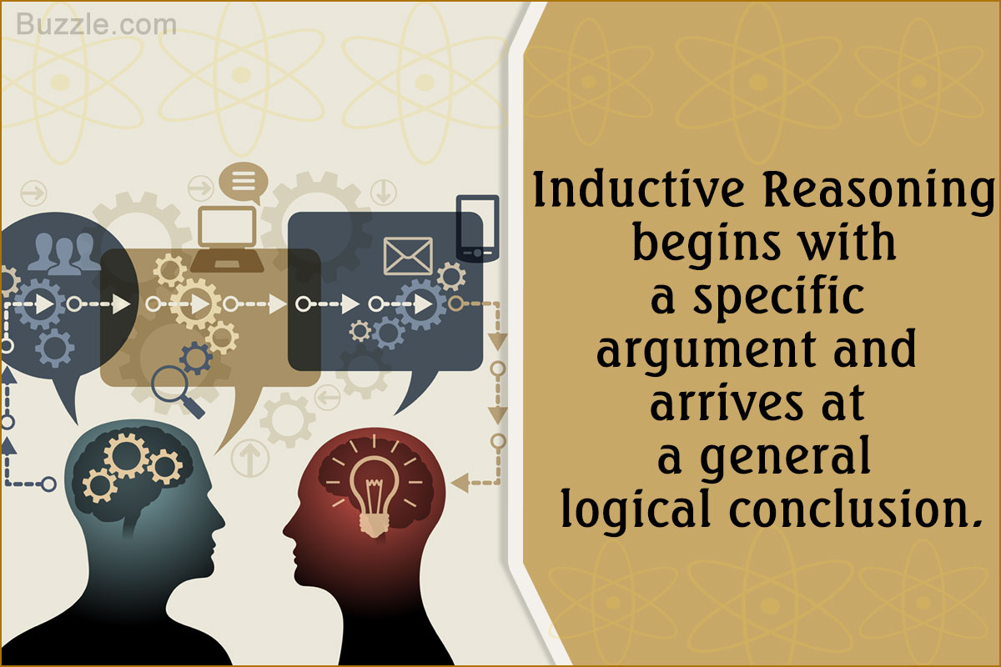
However, how do we know 2?
…by observing a correlation between observed regularities across sufficiently large and representative samples and the unrestricted regularity itself.
Induction is legitimate through another induction
11

Slide 13
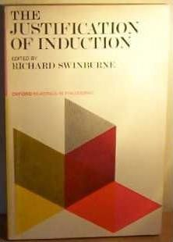
So epistemic support for inductive inferences is circular
Induction is not epistemically justified
12

Slide 14
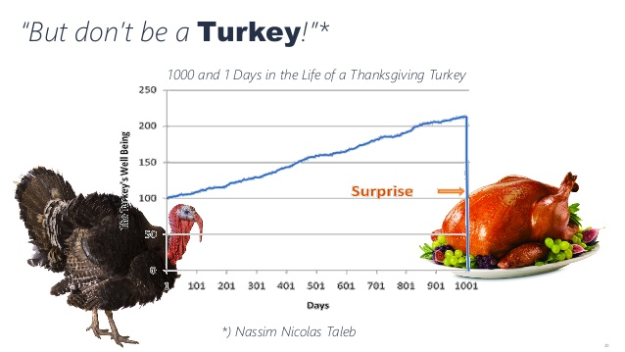
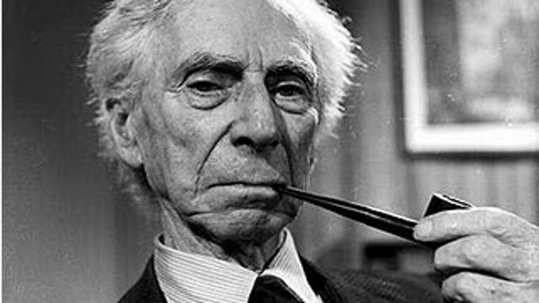

Slide 15
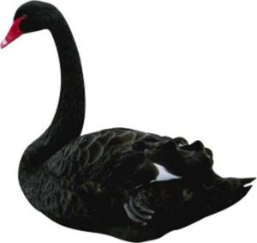
RESPONSES
?
4 Different possible responses…..
a. Induction does not need epistemic justification and we can use it
ad hoc response, begging the question
Intellectually not satisfying
13

Slide 16
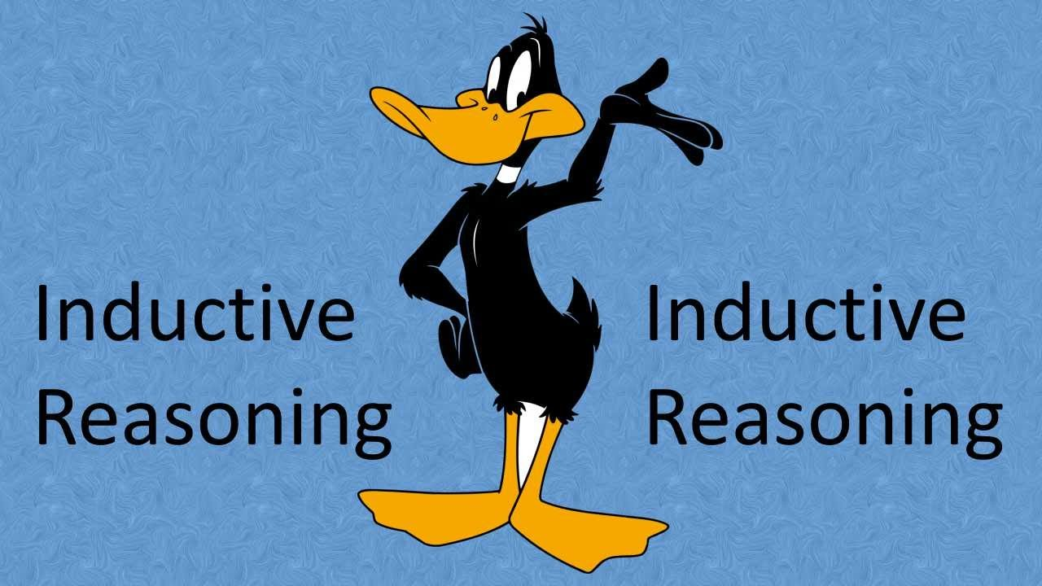
b. EPISTEMIC EXTERNALIST
More sophisticated version, so long as induction works (certain ‘external’ conditions obtain), circularity does not matter so much
14

Slide 17
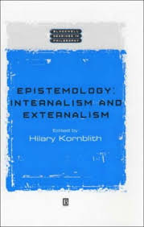
we can a belief in the conclusion of an inductive argument even though we lack any good reason for thinking that this belief is really true (we based our judgment on the idea that induction is itself reliable).
16

Slide 18
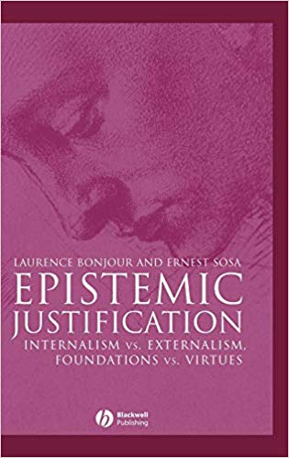
This type of move will not appeal to everyone.
c. The EPISTEMIC INTERNALIST thinks that in order to be justified in holding a belief one must always be in possession of appropriate supporting grounds.
So: which is better
.b or c.?
17

Slide 19

FALSIFICATIONISM
There is a third option:
some argue d. that this is a problem that we can live with
18

Slide 20
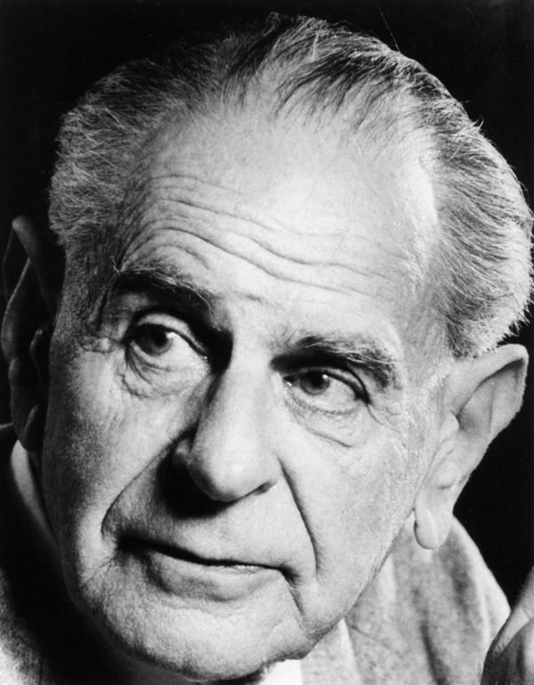
Popper = we can live with this problem because , in fact, science does not use induction that much
Rather science proceeds essentially through deduction, he claimed
19

Slide 21
To understand this claim and his problematicity we need to go back to the Emu example
1* Lots of emus have been observed over many years and in a wide range of environments, and they have always been flightless.
Therefore:
C All emus are flightless
20

Slide 22
This is an inductive inference, since the truth of the premise is compatible
with the falsity of the conclusion
21

Slide 23
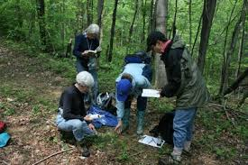
Moreover, it also seems to represent accurately the way in which a scientist might go about discovering that all emus are flightless – that is, observe lots of emus in lots of different conditions and then draw a general conclusion about whether or not they can fly.
22

Slide 24
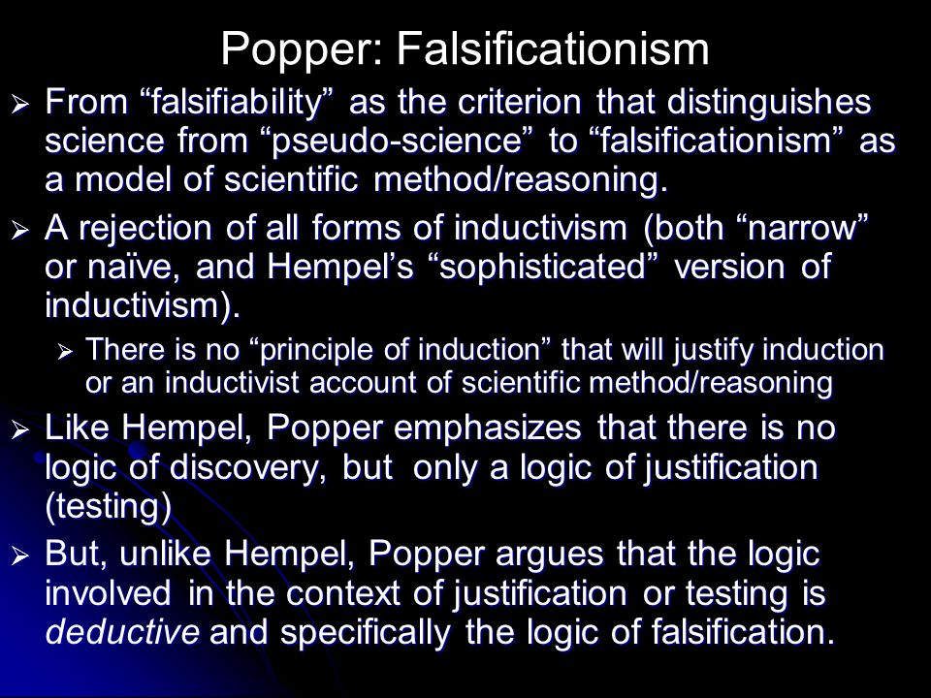
Popper = (NO) science proceeds by making bold generalisations which then tries to falsify – i.e., by trying to show that the bold generalisation is false.
23

Slide 25
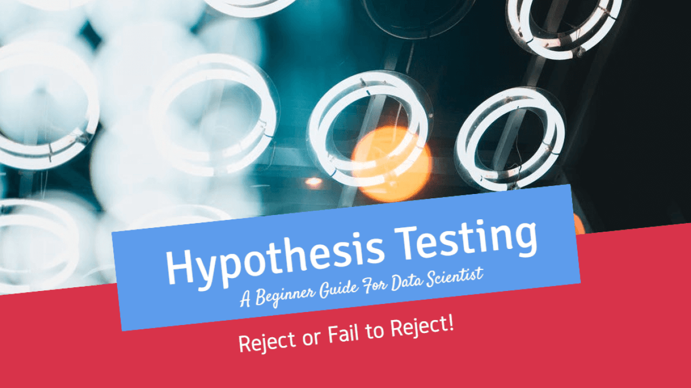
‘Testing’ the hypothesis,
does not mean looking for evidence in its favour, but rather looking
for decisive evidence against it.
EMU case = looking for an emu that can fly
24

Slide 26
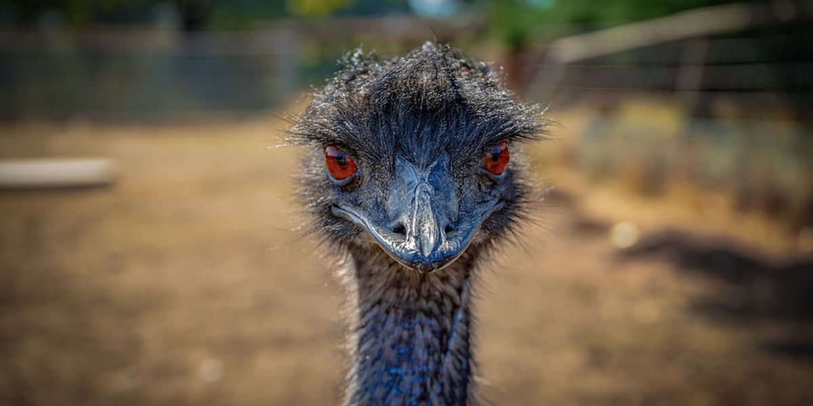
If you try to falsity an hypothesis you use the following logical structure:
First you have your bold hypothesis:
H. All emus are flightless
25

Slide 27
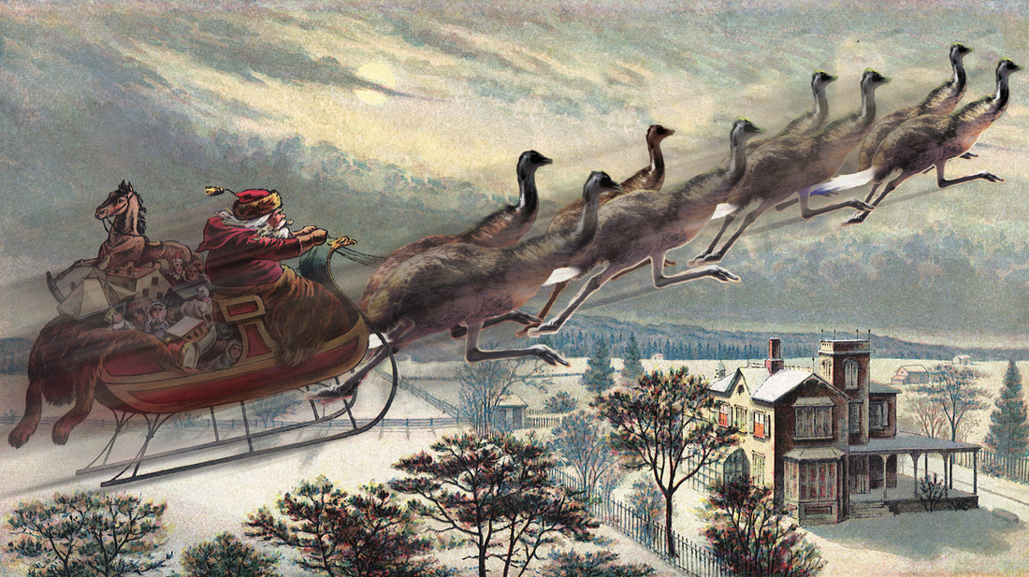
Supposedly we have a counterevidence to H, the observation of a flying emu:
1. There exists a flying emu.
From this observation we can conclude that the bold hypothesis, H, is false,
Since this states that all emus are flightless:
C Not all emus are flightless.
26

Slide 28
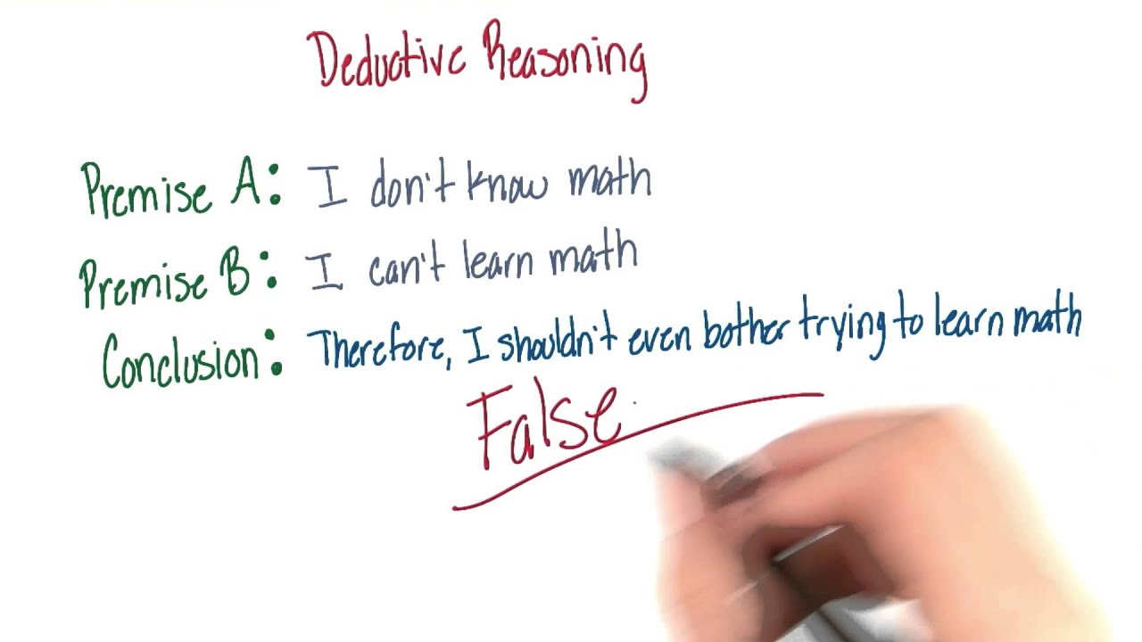
inference from 1 to C is entirely deductive, not inductive!
27

Slide 29
Popper’s idea is thus that by offering bold hypotheses which they try to falsify, scientists are in effect proceeding deductively rather than inductively.
28

Slide 30
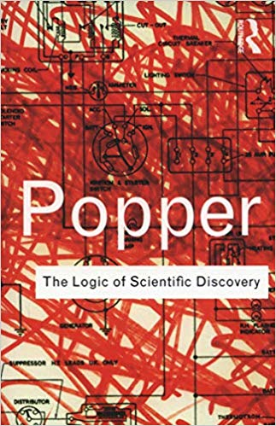
If Popper is right, then it follows that we needn’t be quite as troubled by the problem of induction as we might have thought we should be, since it is not as if as much of our knowledge of the world – gained through
science – is dependent upon induction as we originally supposed.
But does Popper’s rather radical solution to the problem work?
29

Slide 31

2 potential problems
a. If scientific knowledge is understood in this terms, then we don t have much knowledge at all
As it happens, no one has ever observed a flying emu (as far as we know at any rate).
30

Slide 32

Do we not know, then, that all emus are flightless?
Not according to Popper!
31

Slide 33
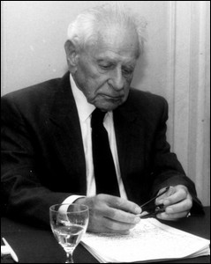
It seems, then, that we can never know the unfalsified generalisations that scientists make; we can only know the falsity of those generalisations that have been shown to be false.
32

Slide 34
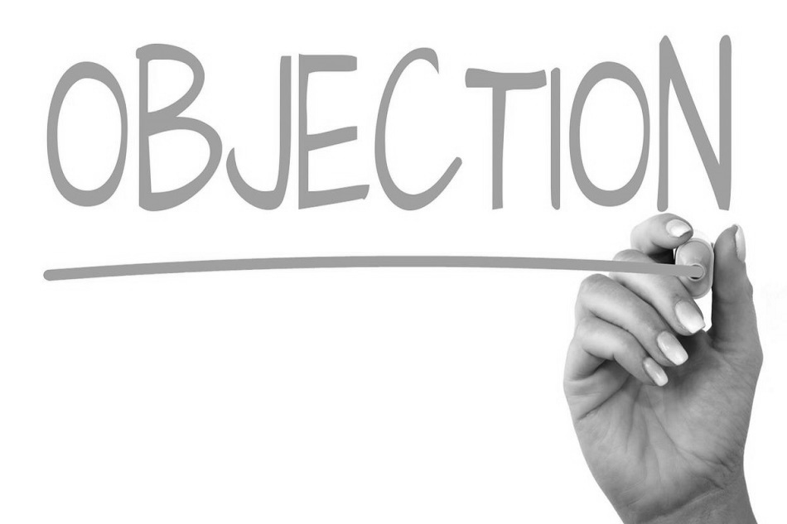
The second problem with Popper’s proposal can be illustrated by an example
Consider again the case of the emus.
33

Slide 35
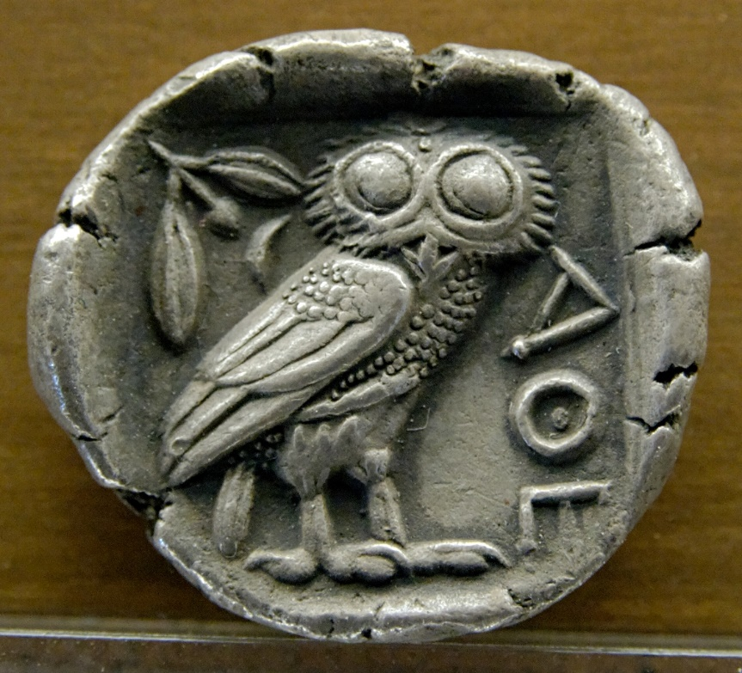
Suppose that for many centuries people had observed that emus were flightless, and so came to believe that all
emus are flightless.
Now suppose that one day a scientist comes into the room and claims that she’s just seen a flying emu.
How would you respond?
34

Slide 36
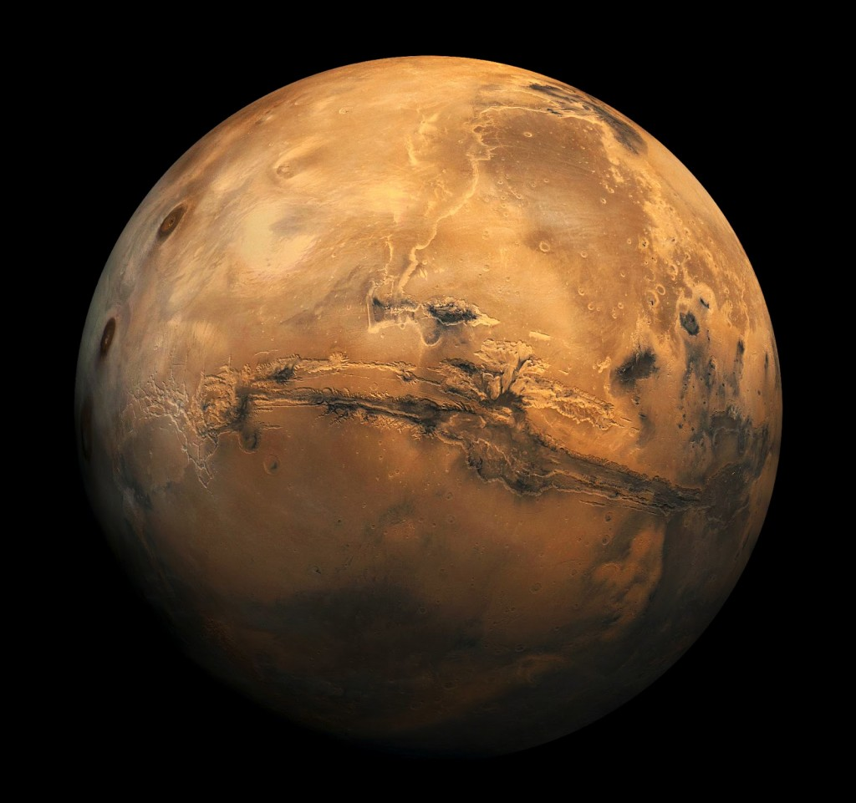
You will first resist this claim
After all, you knowledge seems to be grounded on centuries of observations….
35

Slide 37
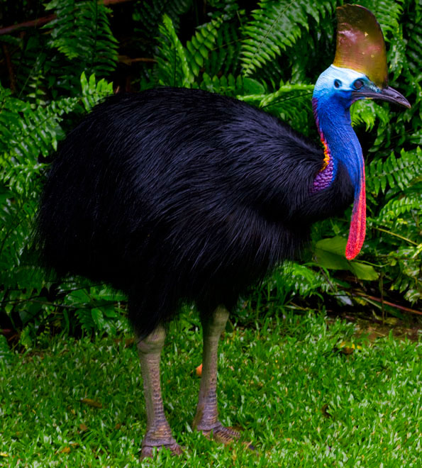
Perhaps you will say that the scientist did not really observed a flying emu or perhaps you will say that he wants to deceive you
Or if you trust the scientist you may respond that she is joking
Or you could say that in the area of the observation there are other birds that looks like EMU but are not
36

Slide 38
IMPORTANT POINT:
We are not obliged to take observations at face value
37

Slide 39
The problem, however, is that if there is rational room for manoeuvre regarding whether one accepts an observation at face value,
then it appears as if there is even less scientific knowledge on the Popperian view than we thought,
since unless one accepts the observation at face value then one can’t make the relevant deductive inference to the denial of the bold generalisation and so come to know that the generalisation is false.
38

Slide 40
UPSHOT:
this view prevents us from knowing, in some cases at least, that any generalisation about the world is true (BECAUSE YOU NEED TO FALSIFY IT)
CONSEQUENCE:
We can have very little scientific knowledge! Only deductive knowledge
39

Slide 41
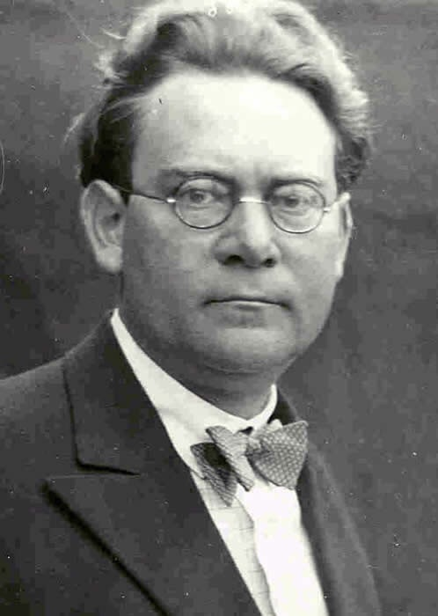
PRAGMATISM (part of epistemic externalism)
A very different way of living with the problem of induction is offered by Hans Reichenbach
40

Slide 42
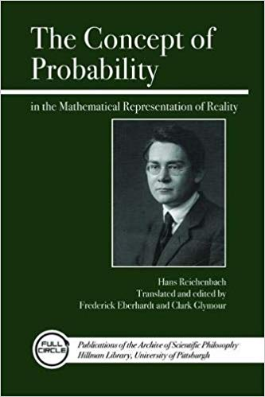
Reichenbach agrees with Hume induction is never justified epistemologically
However,
Induction is rational and even beneficial
41

Slide 43
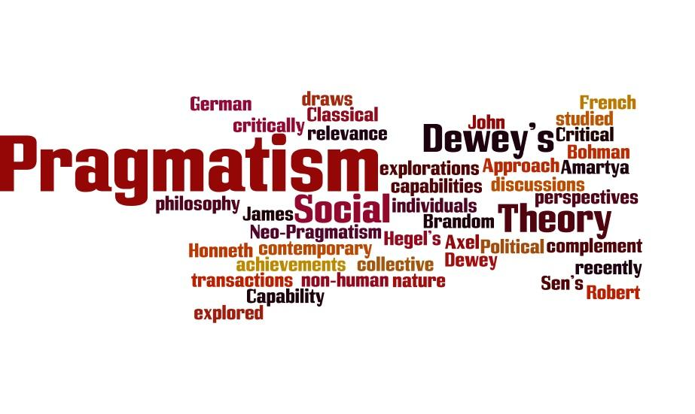
Reichenbach offers a practical – or pragmatic – response to the problem of induction, rather than an epistemic response.
As such this approach can be considered a form of epistemic rationalism
42

Slide 44

To explain Reichenbach’ s point - > example
terminally ill patience has the opportunity of choosing a new experimental operation which may save his life
Operation has not been approved by scientist so it is not epistemically justified
43

Slide 45

REICHENBACH ASKS:
Would you chose to be operated or not?
44

Slide 46
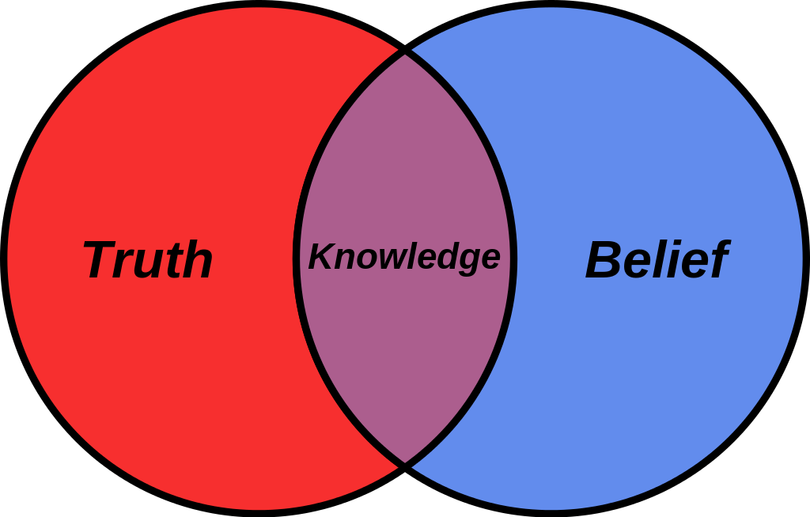
We are in a similar position with induction , Reichenbach says.
By using induction we can get new knowledge, which may turn out to be false yes, but it can also get us to new things (true beliefs)
Conclusion: even if it is not justified we should use INDUCTION because it is rational to do so and may even be beneficial!
NEVERTHELESS: USE INDUCTION WITH A PINCH OF SALT
45

Slide 47
WHAT DID YOU LEARN?
WHAT IS INDUCTION
2. WHY IS INDUCTION PROBLEMATIC?
3. FOUR RESPONSES TO THE PROBLEM OF INDUCTION:
EPISTEMIC INTERNALIST
EPISTEMIC EXTERNALIST
c.FALSIFICATIONISM
d.PRAGMATISM
d. is part of b.
46

